Slide 1
Security in the Internet: Firewall
Uttam Ghosh
uttam.ghosh@vanderbilt.edu
CS Department
Vanderbilt University

Slide 2
Firewall
Security measures (such as cryptography, IPSec) cannot prevent Eve from sending a harmful message to a system. To control access to a system, we need firewalls. A firewall is a device installed between the internal network of an organization and the rest of the Internet. It is designed to forward some packets and filter (not forward) others.

Slide 3
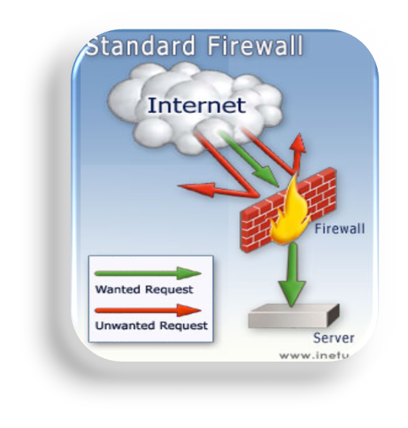
Firewall: Definition
A firewall is a hardware or software or combination of both designed to permit or deny network transmissions based upon a set of rules and is frequently used to protect networks from unauthorized access while permitting legitimate communications to pass.
Firewalls Can Perform Basic Routing Functions

Slide 4
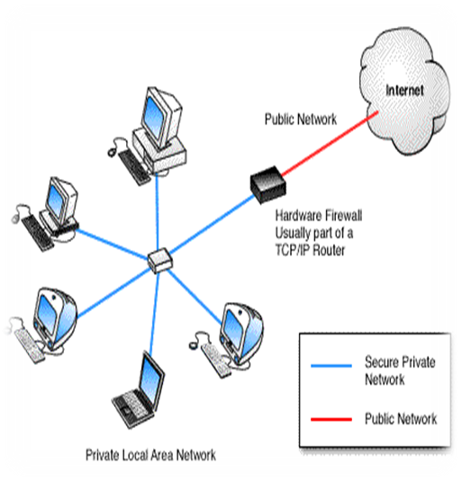
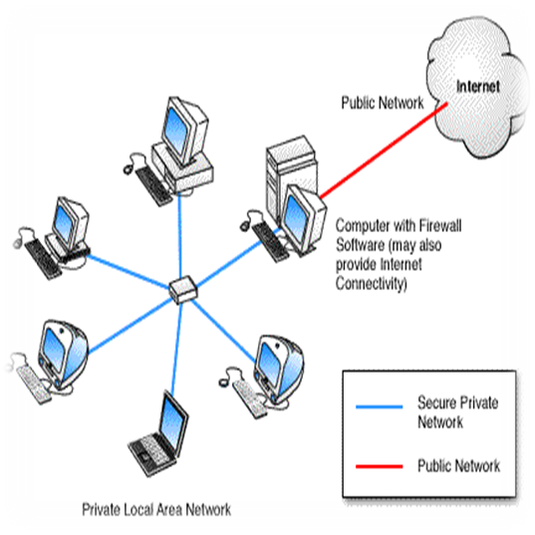
Firewall: Hardware and Software Firewalls
Figure 1: Hardware Firewall.
Hardware firewall providing protection
to a Local Area Network.
Figure 2: Computer with Firewall Software.
Computer running firewall software that provide protection to PC..etc.,

Slide 5
Firewall: Host-based and Network-based
A host-based firewall is installed on an individual computer to protect it from activity occurring on its network.
A network-based firewall is implemented at a specified point in the network path and protects all computers on the “internal” side of the firewall from all computers on the “external” side of the firewall.

Slide 6
Types of Firewalls
1st Generation: Packet Filter (Stateless)
2nd Generation: Proxy Firewall / Application Gateway Firewall
3rd Generation: Stateful Inspection / Circuit-level Gateway Firewall

Slide 7
Packet Filter Firewalls
Treats each packet in isolation
Operates at network layer (layer 3) / transport layer (layer 4) of the OSI model
Filters based on header information in packet (e.g. src/dst IP address, port)
Advantage: speed, application independence, scalability
Disadvantage: Easy to trick – spoofing, fragmenting, etc.

Slide 8
Packet Filter Firewalls
In packet filtering, only the protocol and the address information of each packet is examined.
Its contents and context (its relation to other packets and to the intended application) are ignored.
Filtering consists of examining incoming or outgoing packets and allowing or disallowing their transmission or acceptance on the basis of a set of configurable rules, called policies.
Packet filtering policies may be based upon any of the following:
  Allowing or disallowing packets on the basis of the source IP address
  Allowing or disallowing packets on the basis of their destination port
  Allowing or disallowing packets according to protocol.

Slide 9
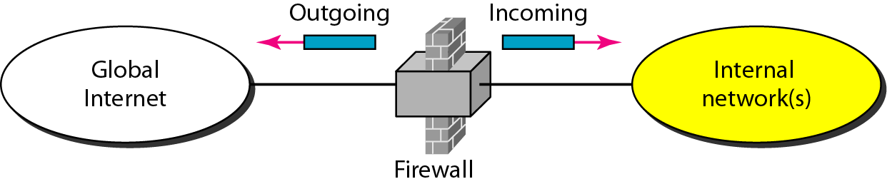
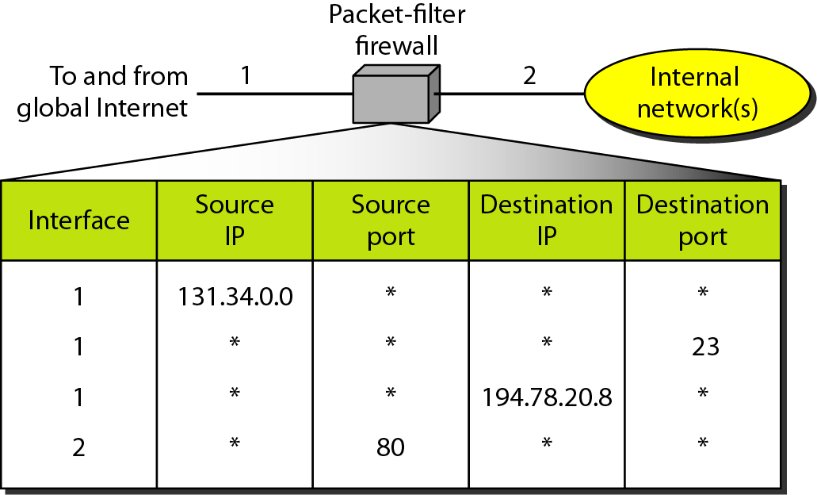
Packet Filter Firewalls

Slide 10
A packet-filter firewall filters at the network or transport layer.

Slide 11
Proxy Firewalls
Client doesn’t actually communicate directly with server
Proxy receives request from client and makes a request to server and returns information to client
It can filter the request from client and filter information returned to client
A proxy firewall can filter higher-layer protocols such as FTP, Telnet, DNS, DHCP, HTTP, TCP, UDP and TFTP
Advantage: More secure than other firewalls
Disadvantage: Slower than packet filter, application specific.

Slide 12
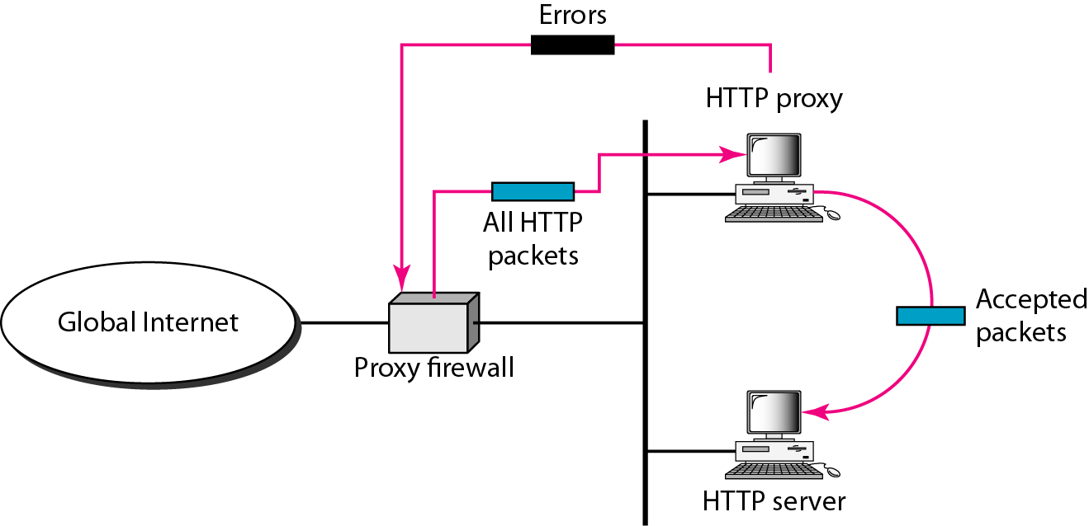
Proxy Firewalls

Slide 13
A proxy firewall filters at the
application layer.

Slide 14
Stateful Inspection Firewalls
Stateful packet inspection maintains record of all connections passing through the firewall and is able to determine whether
        a packet is the start of a new connection,
        a part of an existing connection, or
        is an invalid packet.
This type of firewall can actually be exploited by certain Denial-of-service attacks which can fill the connection tables with illegitimate connections.

Slide 15
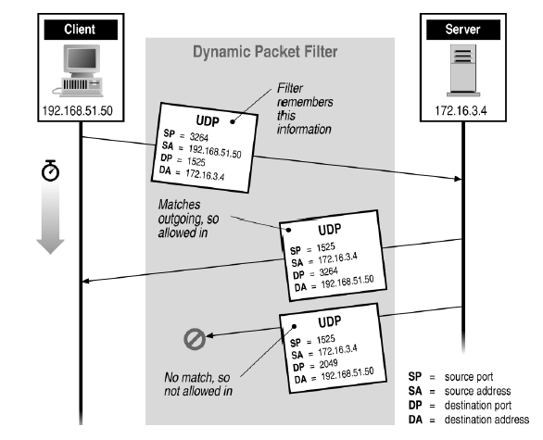
Stateful Filtering

Slide 16
Stateful Inspection Firewalls
Deals with the state of connections (depends on application/protocol used)
Stores the states of legitimate connections in a state table (state information usually stored as hash to make matching faster)
Filters packets by matching to valid states in the state table
Usually takes more time during setup of a new connection (application layer inspection performed usually only at setup)

Slide 17
Limitations of Firewalls
Firewalls are still taken as just the first line of defense of the protected network because they do not assure total security of the network.
Firewalls do not protect against internal threats, and
Firewalls cannot protect against transfer of virus-infected programs or files
Firewalls cannot prevent against previously unknown attack types
Firewalls cannot protect the connections that do not go through it.
Firewalls do not provide data integrity/confidentiality.

Slide 18
Thank You

